Slide 1
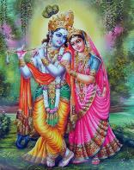
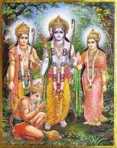

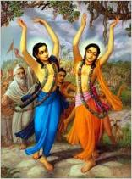
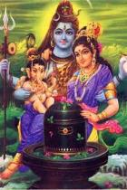
Are you an Indian at heart?

Slide 2
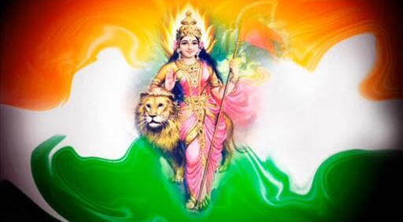
Do you believe in a Divine Mother of All?

Slide 3
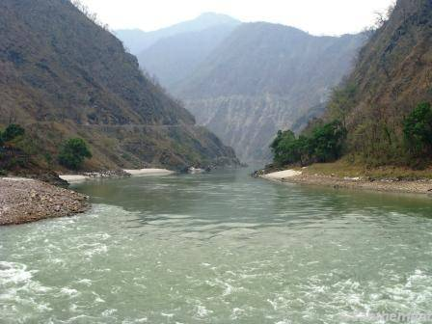
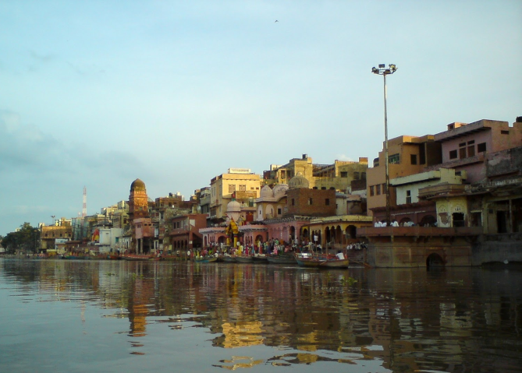
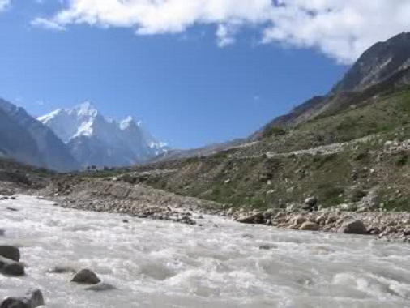
Do you believe in the need of pure water in our rivers?
Ganga Yamuna Saraswati

Slide 4
The Rights to live
Men have Rights
Women have Rights
Animals have Rights
Children have Rights
Rivers have Rights
Bhumi Mata has Rights
Holy Places like Mathura, Vrindavan, Dwarka, Hrisikesh, Haridwar have Rights
Are You ready to defend Them?

Slide 5
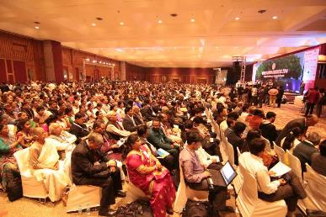
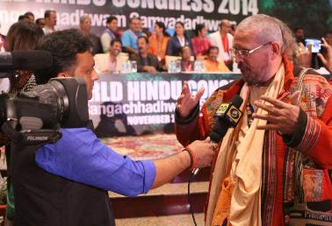
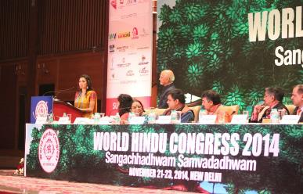
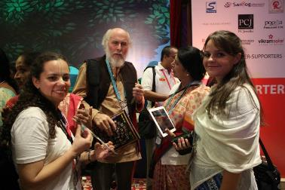
Braj Vrindavan Act Now request all people to become active guardians of these rights

Slide 6
Our inspiration
Om, Sarve bhavantu sukhinaḥ
Sarve santu nirāmayāḥ
Sarve bhadrāṇi paśyantu
Mā kashchit duḥkha bhāgbhavet
Oṁ Shāntiḥ, Shāntiḥ, Shāntiḥ
May all be prosperous and happy
May all be free from illness
May all see what is spiritually uplifting
May no one suffer
Om peace, peace, peace
It is our duty to work so that the whole world is happy.

Slide 7
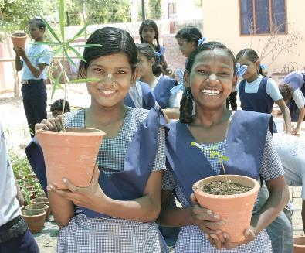
Our Mission
It is our responsibility and also the duty of the every politician, corporation and educator to save this world for our children at any cost

Slide 8
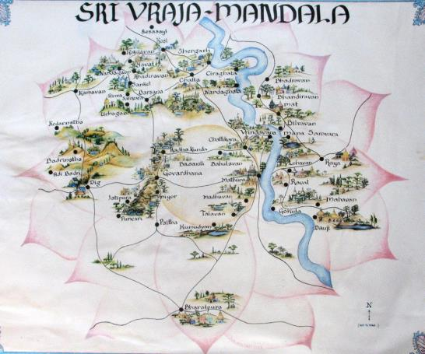
An Eco Braj Mandal: A place of hope.

Slide 9
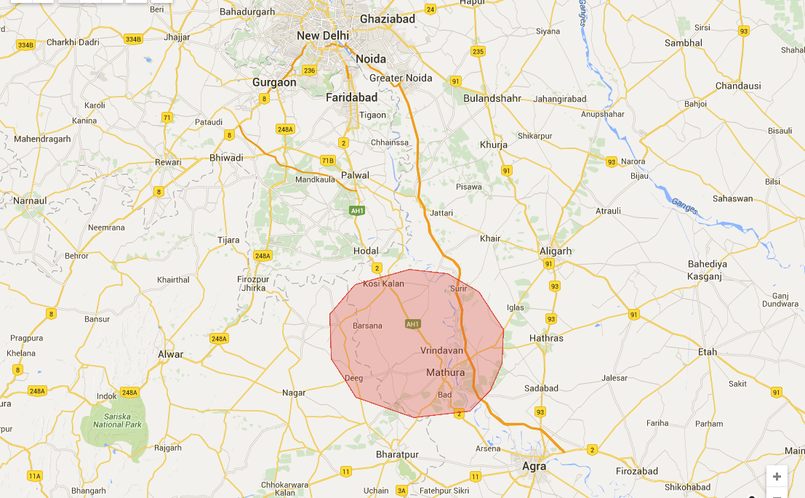
Braj Mandal in India

Slide 10
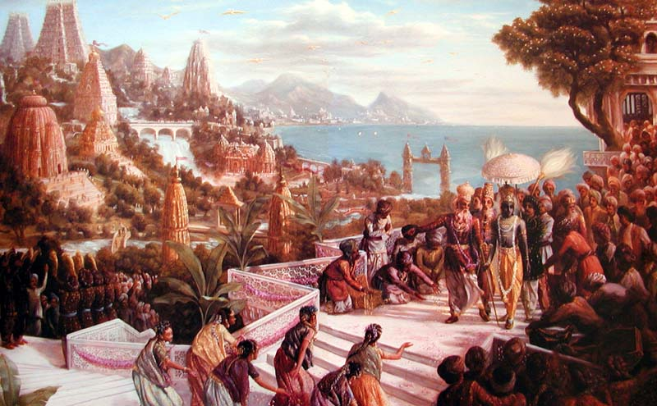
Origen of Bharat Mata’s culture
The ancient Indian culture connected to Lord Krishna was born here, which is testified in the Mahabharata and the Srimad Bhagavatam Mahapurana.

Slide 11
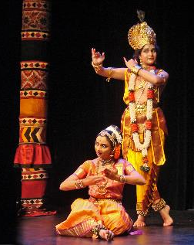
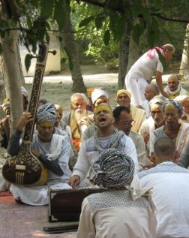
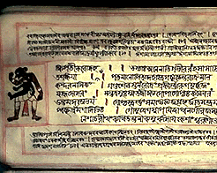
Origen of all the arts
The Braj Mandal is the glorify place in the Sanskrit language, North Indian temple architecture, Indian classical music, Krishna Lila dramas and Indian classical dance.

Slide 12
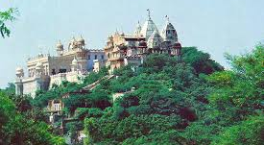
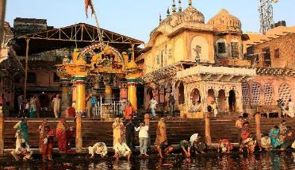
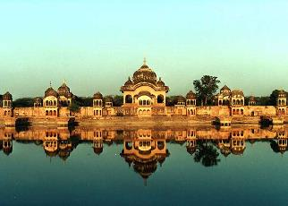
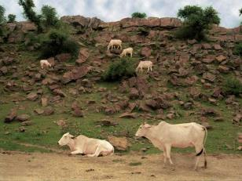
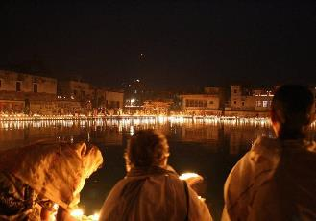
Famous places in Braj Mandal
Vrindavan, Barsana, Mathura, Kusum Sarovar, Govardhan, Kesi Ghat among others

Slide 13
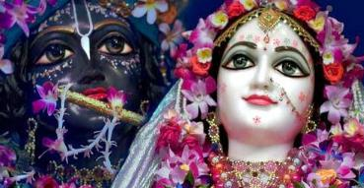
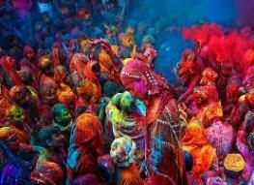
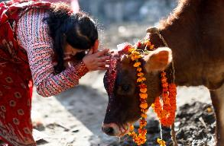
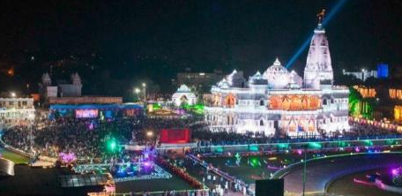
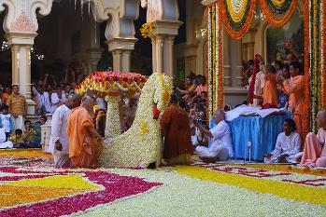
Famous festivals in Braj
Janmastami-Radhastami, Holi, Govardhan Puja, Kartik Vrata among others

Slide 14
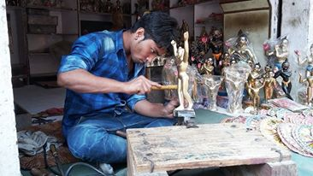
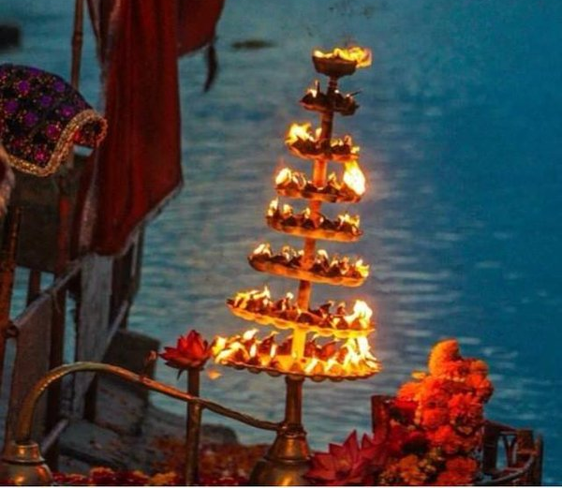
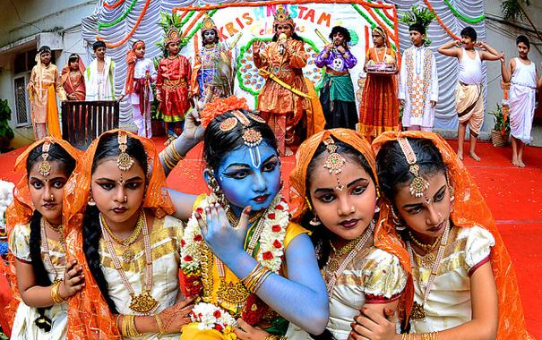
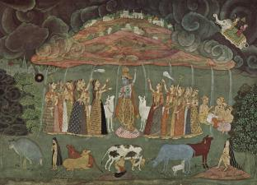
Unique traditions of Braj
Handicrafts, Dance, Music, Puja, Rasa Lila Performances

Slide 15
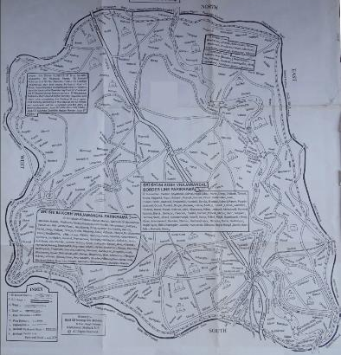
The Famous Parikrama Routes
Yugal Parikrama (Vrindavan-Mathura)
Vrindavan Parikrama
Govardhan Parikrama
Braj Mandal Parikrama

Slide 16
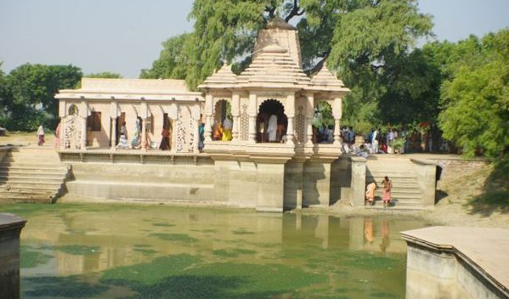
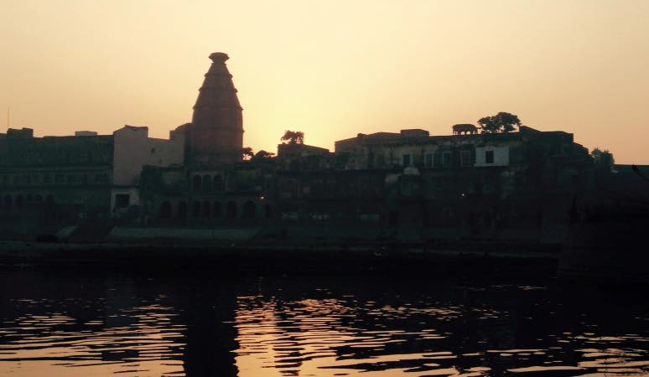
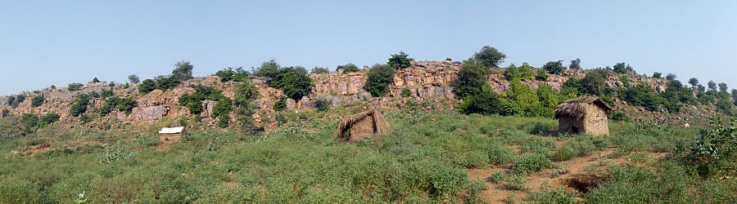
We have to preserve and restore all these medieval heritage sites connected to Lord Krishna, Queen Radha and Lord Balarama
Vrinda Kunda, Kesi Gath, Govardhan hill

Slide 17
Dear President, Prime Minister, State Chief Ministers, MLAs, other officials and friends please allow me to present some problems that…
ONLY YOU CAN SOLVE!

Slide 18
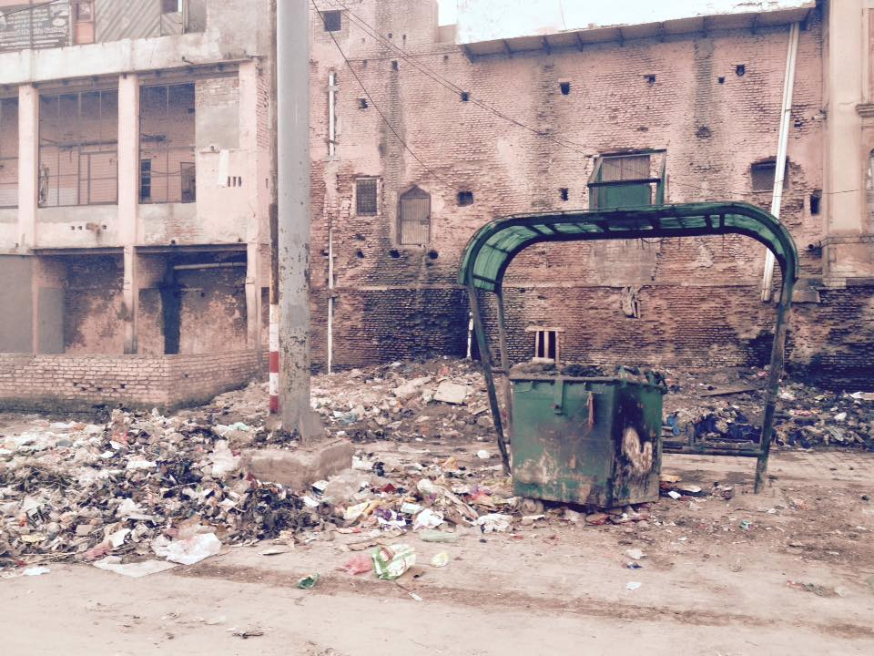
We need your help to improve the problems Braj Mandal is facing:

Slide 19
Our master plan proposals have ideas for:
Solid waste management
Sewage water management
Pillars inside the Yamuna
Planting trees
Traffic management
Maintenance of heritage buildings
Noise pollution
Visual pollution
Burning of plastic
Lack of official recognition to the Dham

Slide 20
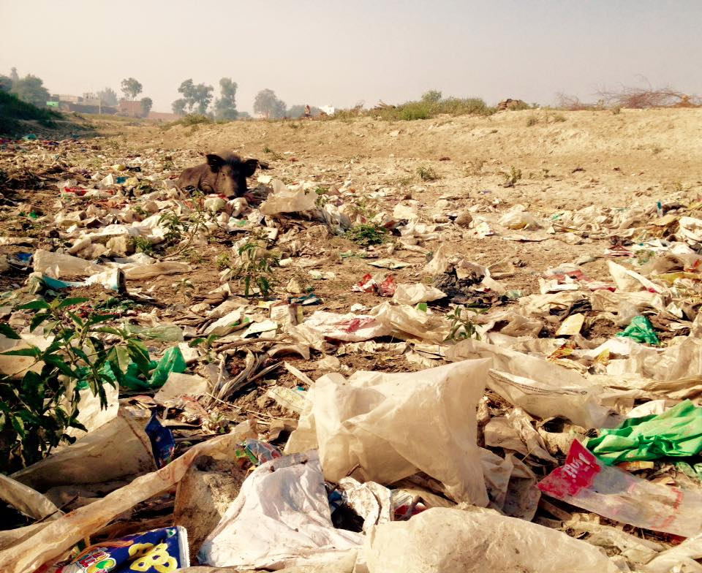
1. Solid waste management
Problem:
The recollection of solid waste must be improved.

Slide 21
1. Solid waste management
Solution:
Turn the recycling of all the waste in the Braj Mandal into a business or have it sponsored to avoid pollution.
Ban the use of plastic in the shops and temples.

Slide 22
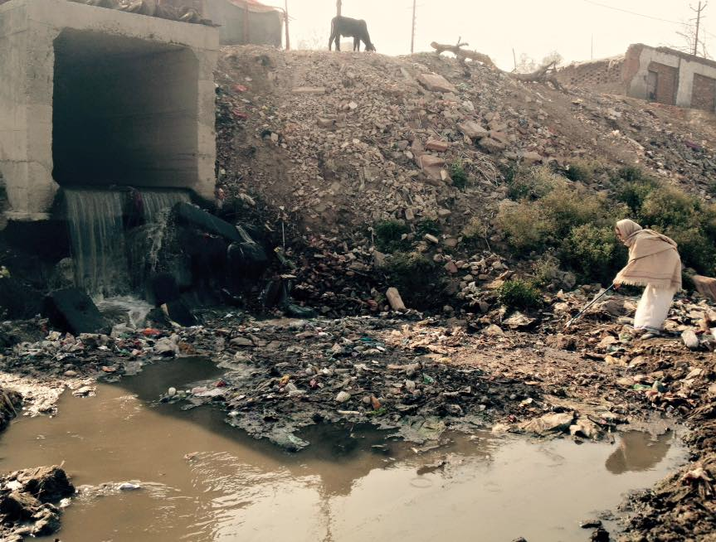
2. Sewage water management
Problems:
Black untreated sewage runs into the river Yamuna.
People cannot even take achman without danger.
The water is dead!
All antibiotic resisting germs infest the water bodies.

Slide 23
2. Sewage water management
Solution:
To build a channel in front of the Ghats to carry the black waters to the STP.

Slide 24
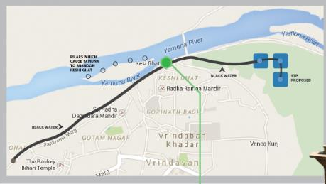

2. Sewage water management

Slide 25
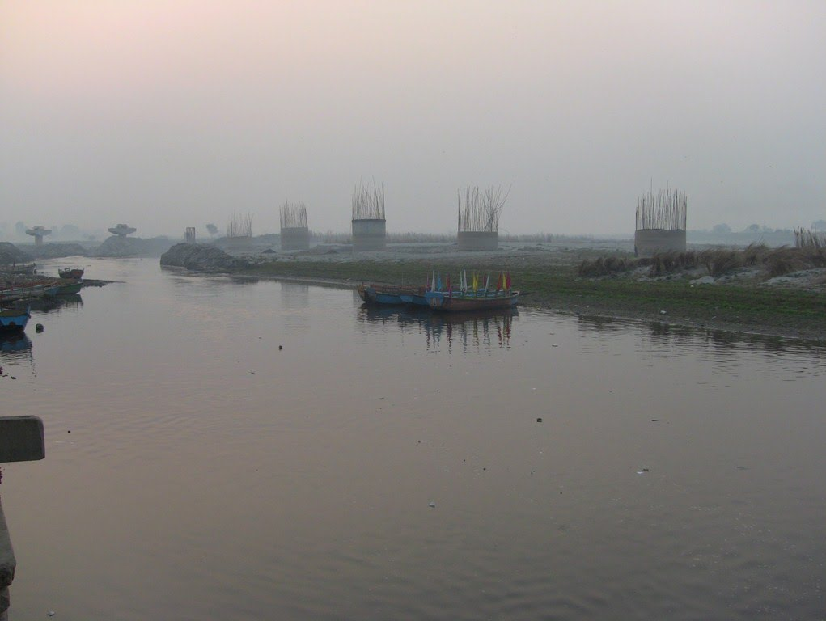
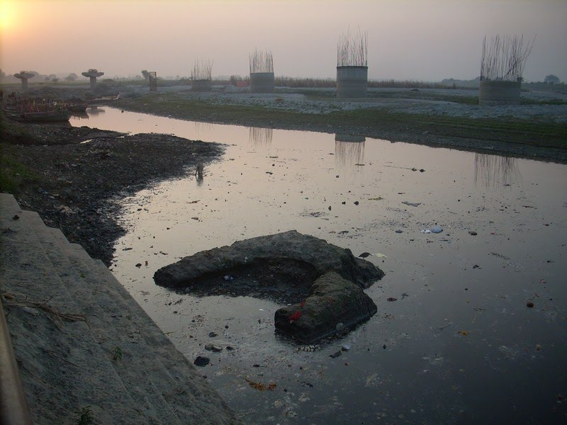
3. Pillars inside the Yamuna
Problem:
These pillars hold back the silt and create a lake of poison that goes down into the ground water.

Slide 26
3. Pillars inside the Yamuna
Solution:
Remove the pillars left by a mistake of the past and dredge the river to flow.

Slide 27
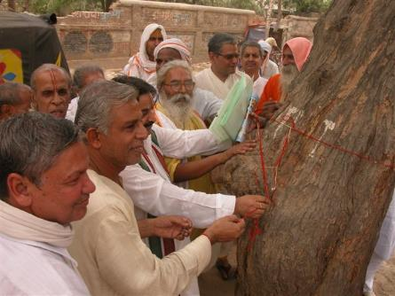
4. Planting trees
Problem:
Trees have been cut and gardens have been destroyed in many places of the Braj.

Slide 28
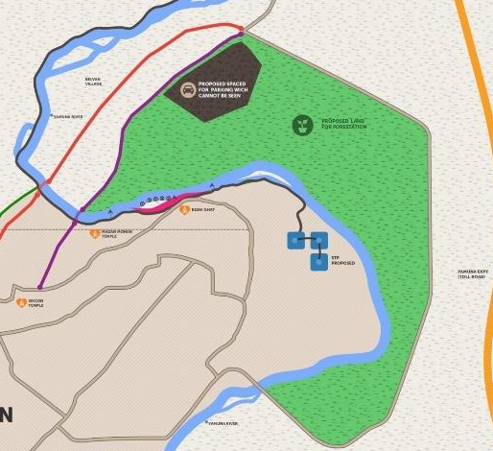
4. Planting trees
Solution:
Reforest other side of the Yamuna and all possible places.

Slide 29
5. Traffic management
Problem:
Traffic of trucks and buses from Delhi, Aligarh and Mathura must be kept out of the city.
Some organizations want to turn the Yamuna Express Way going through Braj Mandal into an industrial area.

Slide 30

5.Traffic management
Solution:
Building a bridge over the Yamuna to create a ring road with access to the Yamuna Express Way would solve all these problems.

Slide 31
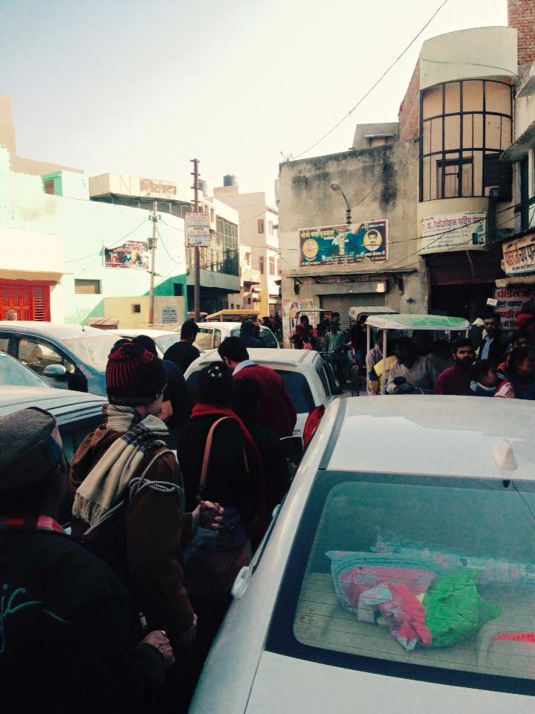
5. Traffic management
Problem:
Many big temples like Prem Mandir, Iskcon, Banke Bihari and others make Chattikara Road a traffic disaster.

Slide 32

5. Traffic management
Solution:
Create a parking place in the other side of the Yamuna with a bridge for riksas and pedestrians to reach Banke Bihari and other old temples (like the Laksman Jhula bridge in Risikesh)

Slide 33

5.Traffic management

Slide 34
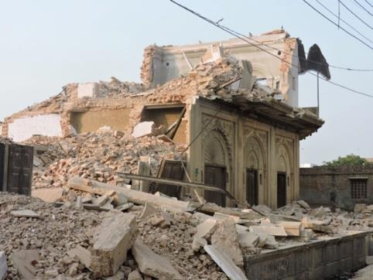
6. Maintenance of heritage buildings
Problem:
Heritage buildings have been neglected and destroyed (for example Mizrapur Dharma Shala in Mathura Road)

Slide 35
6. Maintenance of heritage buildings
Solution:
Heritage buildings need special protection from government agencies.

Slide 36
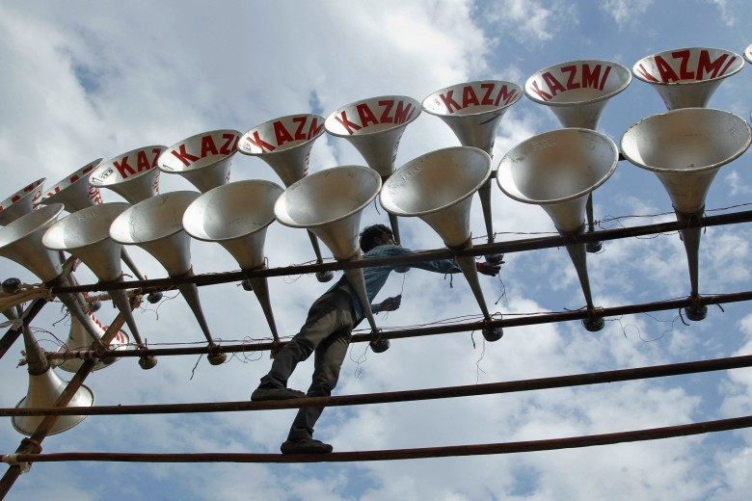
7. Noise pollution
Problem:
Temple horn speakers blast in public areas.

Slide 37
7. Noise pollution
Solution:
Ban speakers directed to public areas.

Slide 38
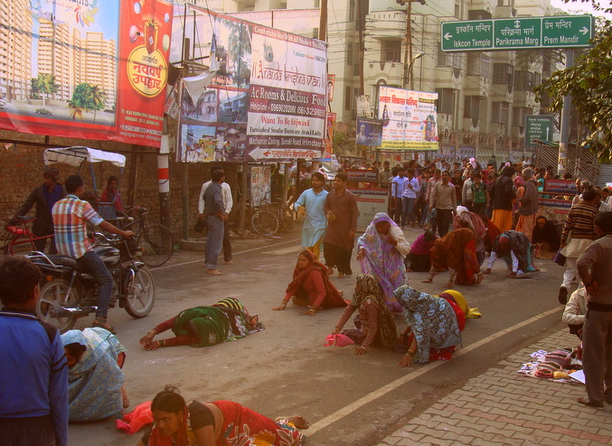
8. Visual pollution
Problem:
The holy places are invisible due to huge billboards all over the streets.

Slide 39
8. Visual pollution
Solution:
Ban billboards and create websites which offer free advertisement service.

Slide 40
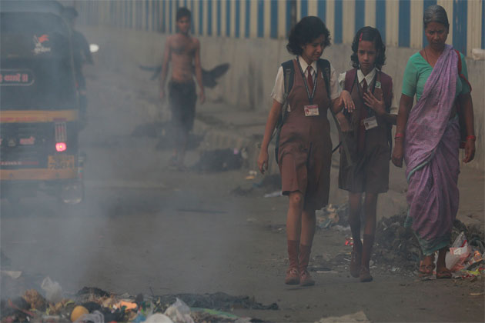
9. Burning of plastic
Problem:
People affect themselves burning plastic which kills their brains and lungs.

Slide 41
9. Burning of plastic
Solution:
Prohibit garbage burning with fines and implement a proper garbage collection system

Slide 42

10. Lack of official recognition to the Braj Dham
Problem
Braj is a place of pilgrimage and needs to become a special protected zone in the three states of Haryana, Rajasthan and Uttar Pradesh
Foto parikram

Slide 43

10. Lack of official recognition to the Dham
Solution
Due to its international importance, the Government of India should request that the Braj is given the UNESCO World Heritage Status.

Slide 44
10. Lack of official recognition
This status has been given in India to trains, churches and to the Taj Mahal.
Why not to Vrindavan a place of historical and international importance?

Slide 45
We have more proposals and master plans created by private initiatives and the Department of Architecture and planning – Indian Institute of Technology, Kharagpur, which you can lookup in our website.
vrindavanactnow.com/proposals-by-others

Slide 46
Our efforts
Dear friends of Bharata Mata and Mother Earth please allow me to present our
Braj Vrindavan Act Now efforts

Slide 47



Our efforts
Our volunteers and hired people can help where Nagar Palika does not have enough manpower:

Slide 48

1. Temple reconstruction

Slide 49


2. Garden development
Radha Gopinath Mandir - Vrindavan

Slide 50

3. Cleaning of the Yamuna banks

Slide 51




4. Websites to serve the Dham to promote ecological awareness

Slide 52

5. Drama presentations to create awareness

Slide 53

6. Cleaning drives
In many holy places like Govardhan, Maan Sarovar, Terkadambha, Pavan Sarovar, Seva Kunja, and sixty four samadhis, among others.

Slide 54

Our petitions to the leaders
To encourage the courts to create environmental protection laws and thus protect Bhumi Mata.
To reforest the land to bring rain fall and clean air back to Braj Mandal.

Slide 55

Munger Raj Awards
The Munger Raj mandir has implemented an award system for any donor in the three following categories:
Individuals
Charity Trusts
Government Organizations.

Slide 56

Munger Raj Awards
How to participate?
Visit the website and report the candidates who have done outstandig service to the Dham. The awards will be given by the King of Munger Ananta Prasad Singh (BV Sadhu Maharaj)

Slide 57

Helping Hands for Vrindavan
Braj Vrindavan Act Now has invited international activists since 2010 called Helping Hands for Vrindavan.
You are invited to participate in it.

Slide 58

Helping Hands for Vrindavan
Sponsor a cleaning helper for emergency situation like this, for 100 USD a month!

Slide 59


Helping Hands for Vrindavan
Or come to Vrindavan and do some volunteer yourself

Slide 60


Helping Hands for Vrindavan
Or sponsor a day of Braj Vrindavan Act Now activities for 11000 rupies (INR).
Food distribution in front of BVAN office

Slide 61

Watch the video of our participation in the World Hindu Congress
Watch on Youtube!

Slide 62
Please Support us! Thank you
We are a registered Trust in Mathura (UP India) and invite you to ACT NOW! for our Bhumi Mata and BRAJ VRINDAVAN

Slide 63

Be careful: You may loose your Heart in Vrindavan
Braj Vrindavan culture is a treasure. Be part of protecting it.

Slide 64

Support us!
Please ACT NOW! With your family, friends and all who can appreciate our activism

Slide 65

Be a donor or part of the action
Braj Vrindavan Act Now needs you to participate!

Slide 66

Our website
Is a guide of the history of Vrindavan, of the the key participants and supporters, of the problems and our efforts to solve them.

Slide 67

Contacts us
Online:
Vrindavanactnow.com

Slide 68

Contacts us
Camp office: Yamuna Kunja Ashram
We are situated on the Yamuna in Vrindavan

Slide 69


Thank you!
To all the organizations who are serving Braj like:
Akshaya Patra,
Braj Foundation,
Brij Vikas Trust,
Friends of Vrindavan,
Friends of Mayapur,
Food For Life ,
Gomata-Bliss,
Ocean of devotion,
World Vaishnava Association,
among others.

Slide 70

Thank you!
To our supporters and specially to Mohan Bhagwatji (director of the RSS) who said:
“I approve of making a special choki dhani like zone of Braj Mandal to protect our cultural heritage…”

Slide 71

BVAN founder
The inspiration and guidance of the BVAN comes from Swami B.A. Paramadvaiti, born in Germany in 1953. He came to India in 1975 as a student of Gaudiya Vaisnavism. Author of Perennial Psicology and active in defending environment in many countries for the last 40 years.
His credentials include:
- Eco Yoga Villages. Permaculture research in 70 locations (see next pages)
- Founder of Conscious Doctors and social welfare programs as The House of Wisdom
- The educational novelty with UNESCO in Innovemos called Faith-Education based in the research in OIDA Therapy and The World Peace Therapy (worldpeacetherapy.com)
- Writer of 200 books and articles, and publisher of millions of books and magazins on healing with yoga and proper diet.
- His own organization VRINDA spans around the planet since 1984 with 40 places of protection and empowering women in the Vishnu Priya Ashram. 100 vegetarian restaurnts, 150 city ashrams and the EcoYoga villages.
- He works with the United Nations of the Spirit as director of the University of Ancient Wisdom (UDSA). He also started the Inbound Yoga School with over hundred branches in the world.
- He lectures daily and is deeply concerned with uplifting Braj Vrindavan from neglect to name, health and glory.

Slide 72




Our ECO yoga Villages
Varsana Ecological Gardens, Vrindavanita, Gambhira Eco Village, Prema Zayuna - Colombia.

Slide 73



Our ECO yoga Villages
Om Ecoyoga Park, Vrindavan Eco Gardens - Sactuary of Mother Earth.

Slide 74




Our ECO yoga Villages
Shanti Dwip , Saraswati Ahimsa Van , Eco Truly Park , Vrinda Bhumi .

Slide 75




Our ECO yoga Villages
Eco Truly Arica, Eka Chakra, Eco Truly Jagannath , Eco Yoga Park.

Slide 76


Our ECO yoga Villages
Nandafalva, Vrinda Kunja.

Slide 77

Produced by
Ambika Dasi and the Helping Hands team:
Hriday Das, Ajay Sanghi, Catur Das, Ragunath Das,
Siddhanta Das, Gopika Dasi, Govinda Dasi & Gandharvika Dasi.
vrindavanactnow.com

Slide 78

Our common goal is love
Sanatan Dharma
That shall unite us for our common duties and goals

